Slide 1

Continuous Delivery With Argo CD

Slide 2
Table of Contents:-
What is Gitops?
Gitops Delivers
Gitops Tools
Argo Cd
Challenges without ArgoCD
Advantages of ArgoCD
What we have choose

Slide 3
What is Gitops:-
Gitops is a new approach to continuous Delivery
Which leverages Git as a single source of truth for declarative infrastructure and applications, providing both revision and change control .
On Git set delivery pipelines make pull requests accelerate and simplify both the application deployment and the operations task to K8s.
Gitops with K8s provide next level of infrastructure-as-code and immutable infrastructure through declarative continuous delivery systems.

Slide 4
Gitops Delivers:-
01. A standard workflow for application development
02. Increased security for setting application requirements upfront
03. Improved reliability with visibility and version control through GIT
04. Consistency across any cluster, any cloud and on-premise environment.

Slide 5

Gitops Tools:-
ArgoCD
Flux CD
Jenkins X
Git agent

Slide 6

ArgoCD:-
Argo CD is a declarative continuous delivery tool for Kubernetes. It can be used as a standalone tool or as a part of your CI/CD workflow to deliver needed resources to your clusters.
Declarative and version-controlled application deployments.
Automation and traceability via GitOps workflow.
Support for Helm, customize and jsonnet applications declarations.
A web UI for visualizing K8s resources.

Slide 7

Challenges without ArgoCD:-
Install and setup tool like Kubectl in each place from where you are trying to deploy.
Configure access to cloud provider if we have our cluster are on Cloud. These will be more security challenges.
Configure access to each K8s cluster to deploy the applications.
We don't have visibility of deployment status.

Slide 8

Advantages of ArgoCD:-
ArgoCD is installed and managed in K8s native way. It is easier to manage than the other two tools-Jenkins and Flux CD.
ArgoCD supports multi-tenancy. On the other hand, Flux CD and Jenkins do not support multi-tenancy application by default.
Cluster transparency
Single interface
Version controlled change
History of change
Better team collaboration
Easy Rollback

Slide 9


Slide 10
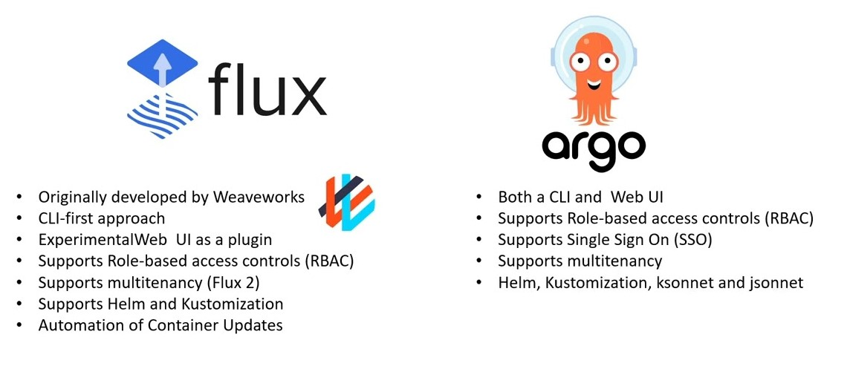

Slide 11
Application Deployment Steps:-
Install Minikube on Ubuntu 22.04 LTS
Update the system packages on Ubuntu 22.04 LTS
$ sudo apt update -y
install below packages for minikube
$sudo apt install curl wget apt-transport-https –y\
Install Docker on Ubuntu 22.04 LTS
$ sudo apt install docker.io
Configure to Run docker without sudo permission
$ sudo usermod -aG docker $USERsudo chmod 666 /var/run/docker.sock
To check whether virtualization support is enabled on your machine or not
$ egrep -q 'vmx|svm' /proc/cpuinfo && echo yes || echo no

Slide 12
install the KVM and and other tools on Ubuntu 22.04 LTS
$ sudo apt install qemu-kvm libvirt-clients libvirt-daemon-system bridge-utils virtinst libvirt-daemon
Add your user to libvert group
$ sudo adduser -a $USER libvirt $ sudo adduser -a $USER libvirt-qemu
Reload Group:
$ newgrp libvirt $ newgrp libvirt-qemu
To download latest minikube setup refer minikube official download page
$ curl -LO https://storage.googleapis.com/minikube/releases/latest/minikube-linux-amd64
Install Minikube on Ubuntu 22.04 LTS
$ sudo install minikube-linux-amd64 /usr/local/bin/minikube
To check minikube version on Ubuntu
$ minikube version

Slide 13
Install kubectl on Minikube
Download kubectl binary with curl on Ubuntu using below command
$ curl -LO "https://dl.k8s.io/release/$(curl -L -s https://dl.k8s.io/release/stable.txt)/bin/linux/amd64/kubectl"
Make the kubectl binary executable
$ chmod +x ./kubectl
Make the kubectl binary executable
$ sudo mv kubectl /usr/local/bin/
To check kubectl version on Ubuntu
$ kubectl version --client --output=yaml
Start the minikube Kubernetes cluster on Ubuntu
$ minikube start --vm-driver docker
To Check the status of Minikube
$ minikube status

Slide 14
Install ArgoCD on Minikube
There are several driver options that you can use to start a minikube cluster (virtualbox, docker, hyperv).
We are using driver as docker
$ minikube start --driver=docker
Just like other Kubernetes tools, ArgoCD requires a namespace with its name. Therefore, we will create a namespace for argocd.
$ kubectl create ns argocd
ArgoCD can be installed using its manifests. First, you’ll need to download these manifests and apply them to your Minikube cluster.
$ kubectl apply -n argocd -f https://raw.githubusercontent.com/argoproj/argo-cd/v2.5.8/manifests/install.yaml
Let’s verify the installation by getting all the objects in the ArgoCD namespace.
$ kubectl get all -n argocd

Slide 15
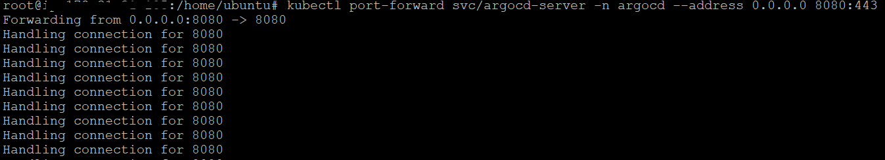
Access ArgoCD UI on Browser
By default, the ArgoCD server is not exposed outside the cluster. You can expose it using port-forwarding to access the ArgoCD UI.
$ kubectl port-forward svc/argocd-server -n argocd --address 0.0.0.0 8080:443
Output:-

Slide 16
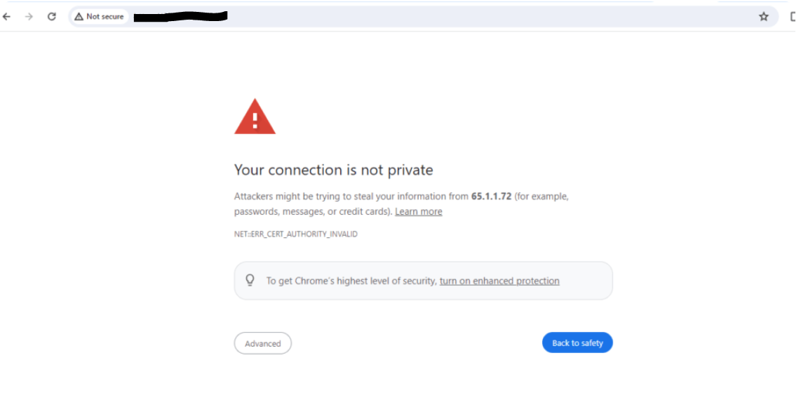
The ArgoCD UI will be available at http://localhost/IP:8080. Access it through your web browser.
Now we can go to a browser and open instance_ip:8080

Slide 17
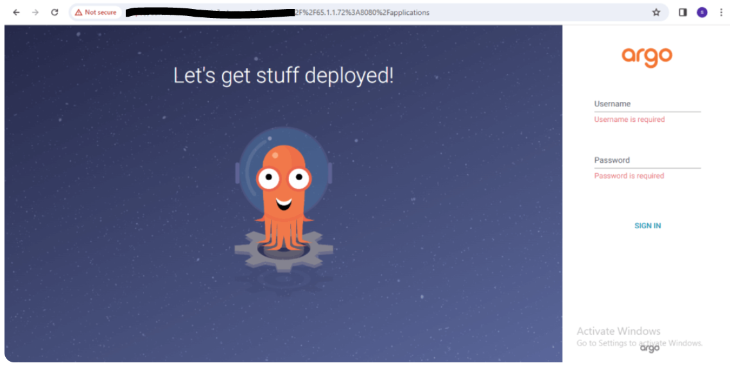
Note:- You will see a privacy warning. Just ignore the warning, click on Advanced and then hit on Proceed to localhost (unsafe) to continue to the GUI interface. (Your browser setting may present a different option to continue).

Slide 18
Get the initial password for the admin user to log in
kubectl -n argocd get secret argocd-initial-admin-secret -o jsonpath="{.data.password}" | base64 –d; echo
Output:-

Slide 19
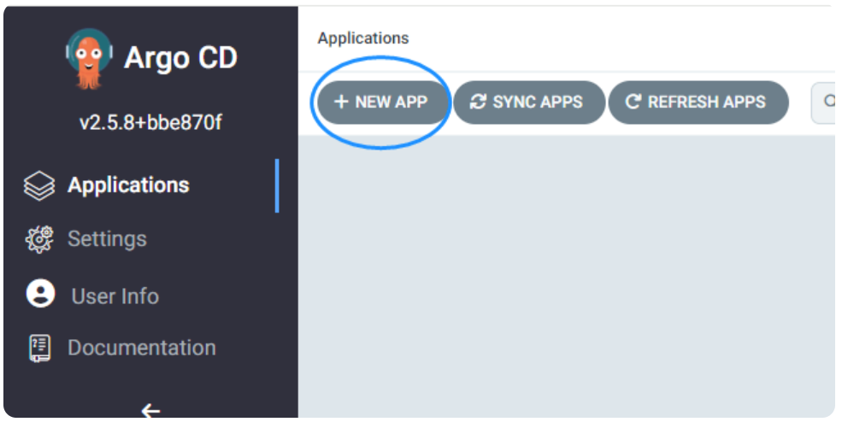
Deploying an app on ArgoCD
Now that we are in the user interface, we can create a new app. The source code for my application is in my Github repo, so We will connect my Github repo to ArgoCD.
After logging in, click the + New App button as shown below:

Slide 20
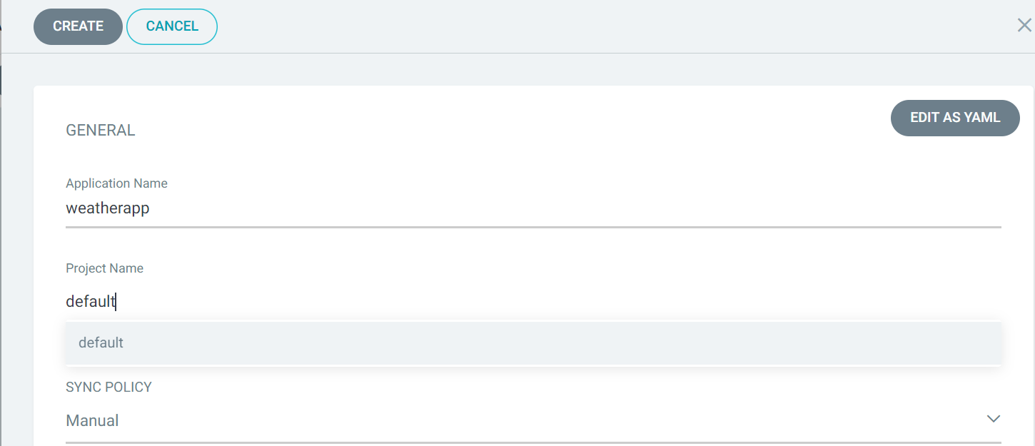
Give your app the name weatherapp, use the project default, and leave the sync policy as Manual:

Slide 21
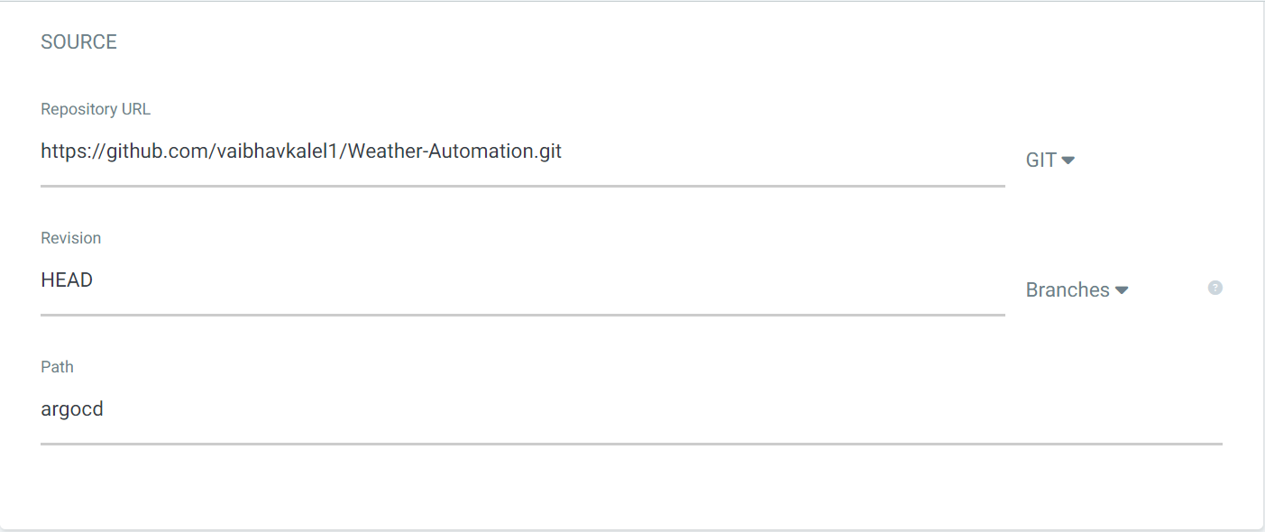
Connect the https://github.com/vaibhavkalel1/Weather-Automation.git repo to Argo CD by setting repository url to the github repo url, leave revision as HEAD, and set the path to guestbook:

Slide 22
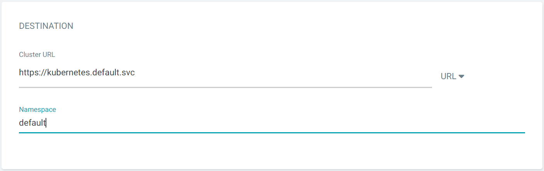
For Destination, set cluster URL to https://kubernetes.default.svc (or in-cluster for cluster name) and namespace to default:

Slide 23
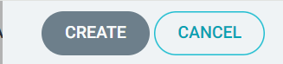
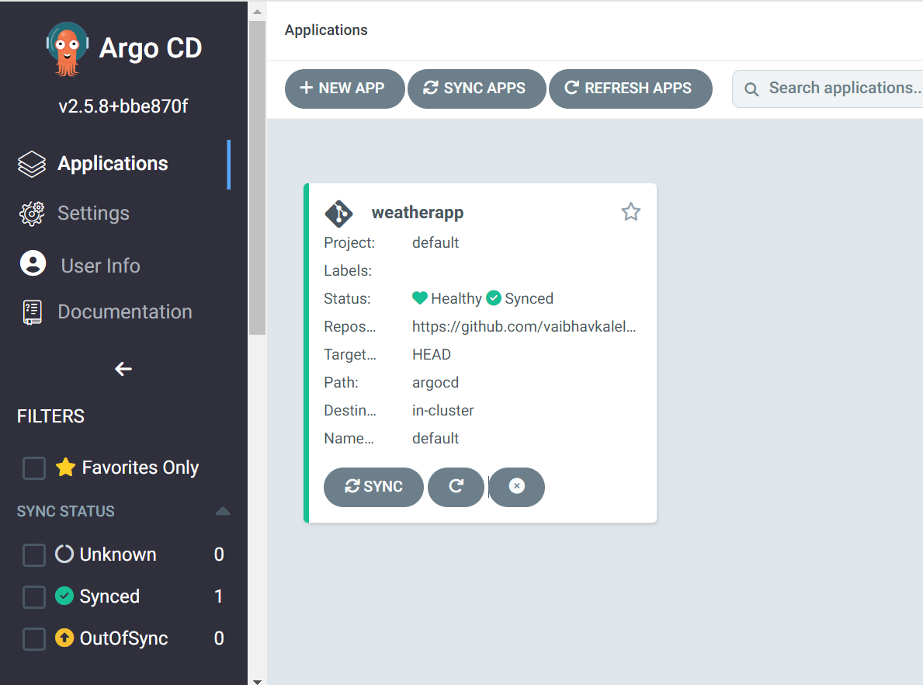
Click on Create after that you can see

Slide 24
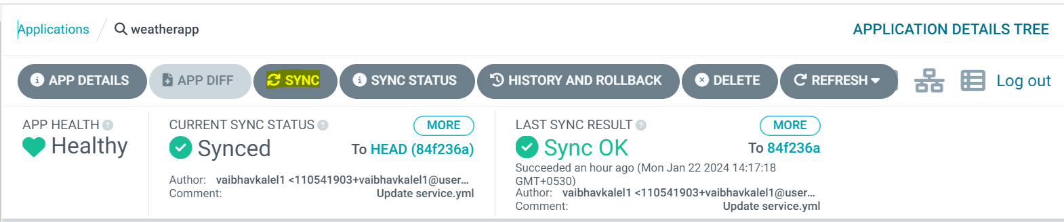
Click on weatherapp then you will see the result and Click on SYNC

Slide 25
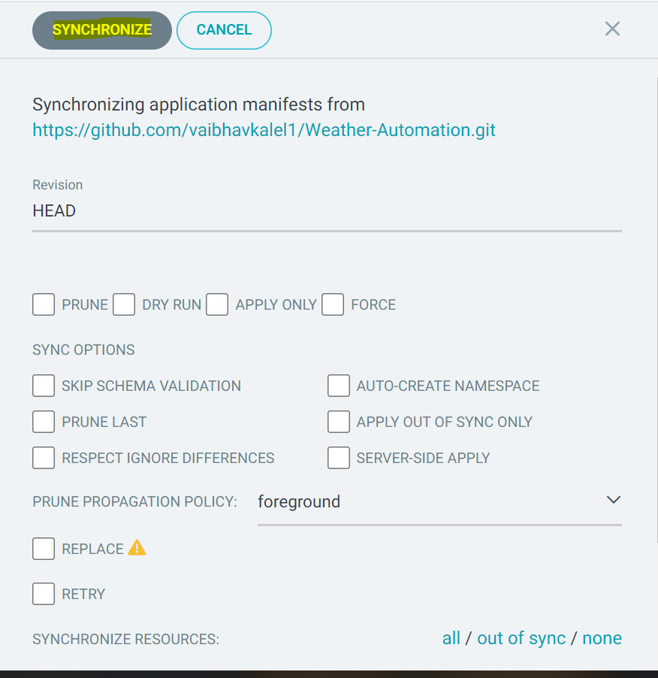
Click on Synchronize

Slide 26
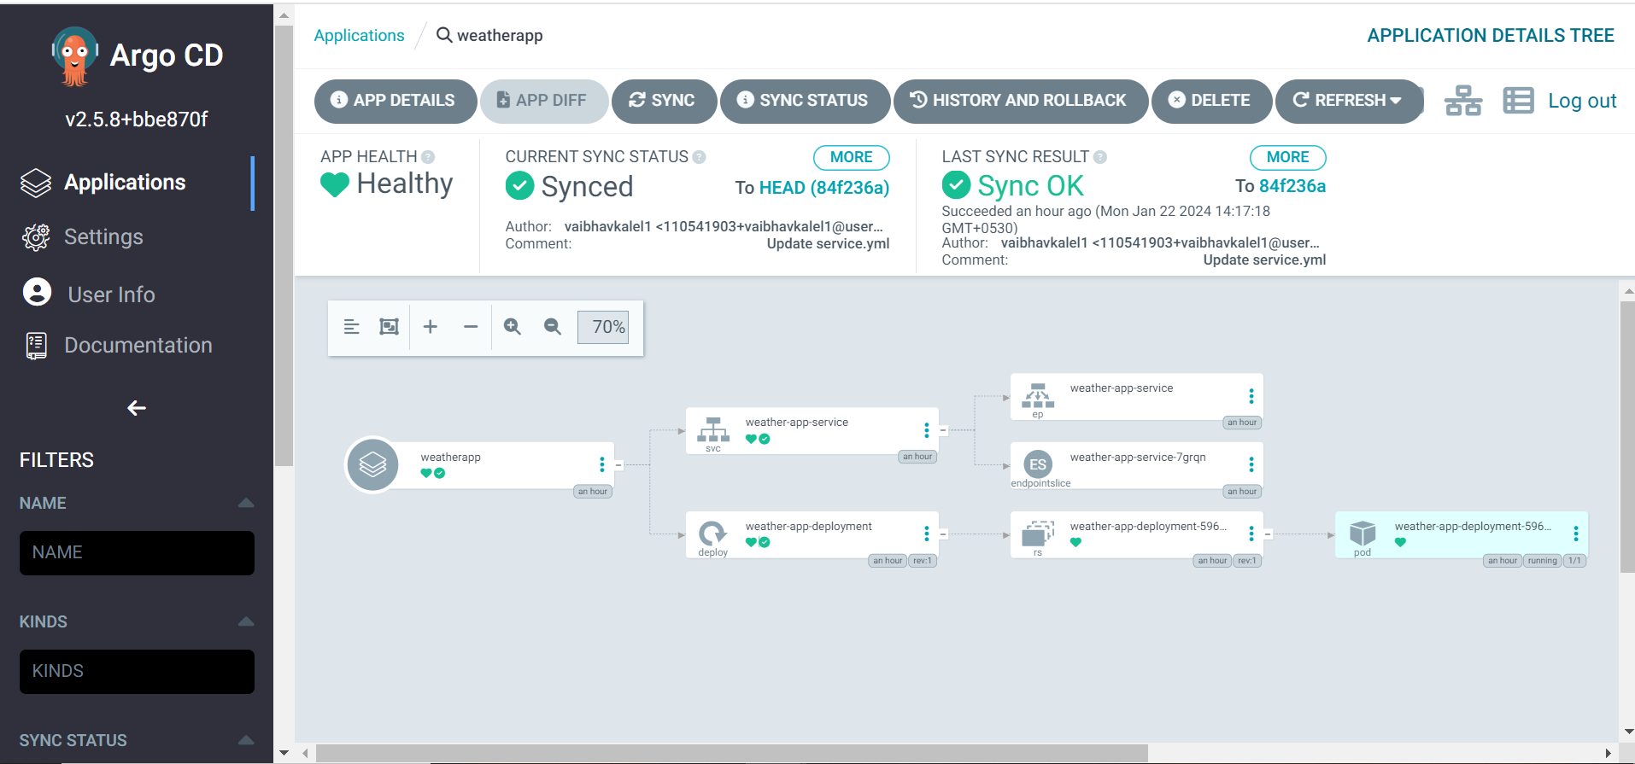
Now we can App got deployed on ArgoCD.

Slide 27
Thank You...!!!

